Slide 1

CYBERSECURITY SOLUTION
Suraksha
Your Gateway to a Safer Web
Real-time Threat Detection via Web and Extension
Objective
Bridging the gap between user browsing and cybersecurity

Slide 2
PRESENTATION FLOW
Overview
01
The Security Challenge
02
Feature Access Methods
Understanding the rising sophistication of web threats and user vulnerability
Dual-platform approach: Website and Browser Extension
03
Website Experience
04
Extension Experience
Proactive link verification through secure sandbox environment
Passive, real-time protection with intelligent monitoring
05
User Experience Comparison
06
Conclusion & Roadmap
Side-by-side analysis of both protection methods
Unified safety approach and future enterprise scaling

Slide 3
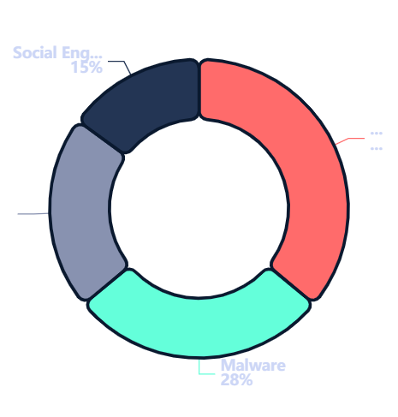
THE PROBLEM
The Security
Challenge
Threat Landscape
Rising Web Threats
Phishing, malware, and deceptive URLs are becoming increasingly sophisticated . Attackers employ advanced social engineering tactics, AI-generated content, and zero-day exploits to bypass traditional security measures.
The User Dilemma
Users often lack the technical expertise to judge if a link is safe before clicking. This knowledge gap creates a critical vulnerability in the security chain, making users easy targets.
Our Goal
Statistics
Provide a dual-layered approach to security that fits into any workflow—protecting users without disrupting their browsing experience.
Phishing attacks increased by 61% in 2024, with average cost per breach reaching $4.45M

Slide 4
DUAL-PLATFORM SOLUTION
Suraksha Feature Access Methods
The Extension
Browser Integration
Available on
Chrome, Edge, and Firefox Web Stores
Designed for
Passive, automated protection
Ideal Users
Busy professionals who want seamless background protection
Protection Type: Real-time automated monitoring
Complementary Approach: Both methods work together to provide comprehensive protection—choose based on your workflow needs

Slide 5
PASSIVE PROTECTION
Feature Deep Dive – The Extension Experience
Simple Installation
Extension Features
One-click setup via the Browser Web Store. No configuration required—install and forget.
Zero Latency
Real-time Scanning
Threat Database
Runs quietly in the background without affecting browsing speed . Optimized for minimal resource usage.
Every link checked instantly
Updated hourly
Intelligent Monitoring
Analyzes traffic in real-time using advanced ML algorithms to detect threats before they reach you.
Smart Alerts
Activity Log
Context-aware warnings
Track blocked threats
Active Alerts
Visual pop-ups and warnings appear only when danger is detected —no annoying interruptions.
Performance Metrics
CPU Usage
< 1%
Memory Footprint
< 50MB
Scan Speed
< 100ms

Slide 6
COMPARATIVE ANALYSIS
Comparing User Experiences
Comparison Factor | Website | Extension
User Intent | Proactive Intentional, deliberate checking | Passive Automatic, background protection
Setup Complexity | None—just visit website | One-click install
Real-time Protection | On-demand scanning | Continuous monitoring
Visual Feedback | Live screenshots + reports | Alert pop-ups only
Ideal Use Case | Verifying links from emails, messages, or unfamiliar sources | Daily browsing protection without interruption
Best For | Security-conscious users who verify before clicking | Busy professionals wanting seamless protection
Recommendation: Use both methods together for maximum protection—Extension for daily browsing, Website for suspicious links

Slide 7

LOOKING AHEAD
Conclusion & Future Roadmap
Unified Safety
Ongoing Updates
Next Steps
Suraksha offers flexibility —manual verification for the cautious, and automatic protection for the busy.
Continuous database refreshes to catch "Zero-Day" threats before they spread.
Scaling API access for enterprise-level security solutions.
Update Schedule
Enterprise Features
Key Benefits
Threat Database
Hourly
RESTful API integration
Dual-layer protection
ML Models
Weekly
Bulk URL scanning
Zero technical expertise required
Feature Updates
Monthly
Custom threat rules
Seamless workflow integration
Analytics dashboard
Security Patches
As needed
Visual confirmation before risk
SSO & team management
Suraksha: Protection That Adapts to You

